Slide 1
Convolutional Neural Networks
Notes:
The specific neural network that accomplishes these tasks

Slide 2

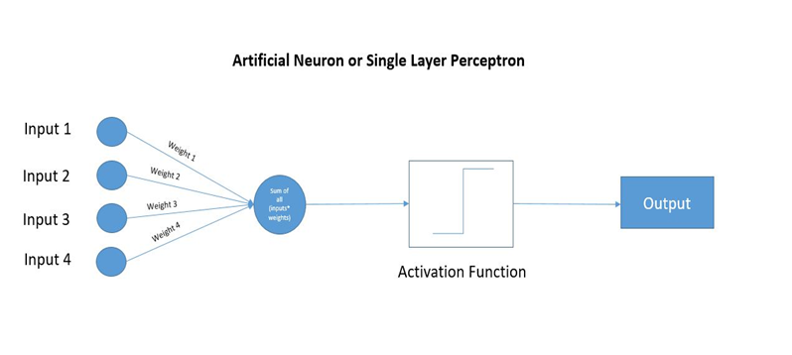
Quick Recap on NN
A neural network takes certain number of input/features and pass it through multiple layers of calculations.
Each neuron, also depicted as a node in the figure, computes a linear function (using weights and biases) before pushing it to a function called activation function which operates on its input to give an output.
Forward propagation for calculation and backward propagation for loss reduction
Notes:
For the rest of the components in a Neural network

Slide 3
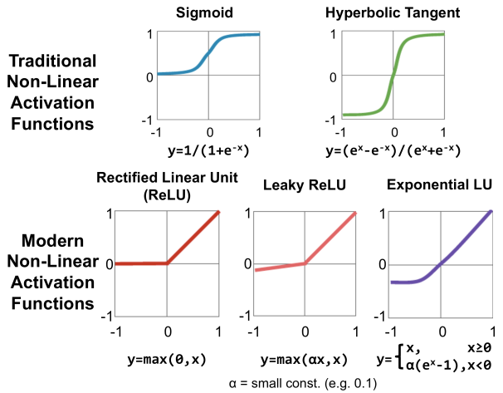
Activation Functions
Notes:
input into the activation function is W*x + b where W is the weights of the cell and the x is the inputs and then there is the bias b added to that. This value if not restricted to a certain limit can go very high in magnitude especially in case of very deep neural networks that have millions of parameters. This will lead to computational issues.
pattern that defines this classification is simply not linear. In come the artificial neural networks. What if we use an ANN with a single cell but without an activation function. So our output is basically W*x + b. But this is no good because W*x also has a degree of 1, hence linear and this is basically identical to a linear classifier.
Softmax activation function - generic form of sigmoid (K classes)

Slide 4
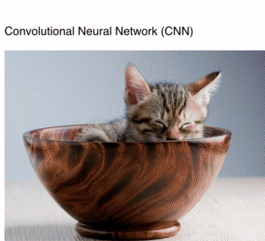
How do CNNs work?
Instead of pixel by pixel, CNN breaks image down into groups of pixels.
CNN preserves the spatial relationship between pixels by learning localized image features using small filters (kernels).
This is done by a series of matrix multiplications, specifically convolutions, between the group of pixels and a kernel. This is compared against specific pixels in a pattern which the CNN is looking for.
Notes:
Preserves spatial data hence, suitable for images.

Slide 5

CNN Architecture
The first conv layer extracts general features like edges, curves. Subsequent layers extract more detailed features like shapes, follows by more complex features like objects, etc (hierarchical).
Input
Convolution
Pooling
Dropout
Fully Connected
Output
Hidden layers
Notes:
input (224x224x3) → convolutional layers → last feature map (7x7xchannels) → global average/max pooling → 1x1xchannels → fully connected layers → output

Slide 6

Input Layer
Matrix of pixels with a given width (W) and height (H)
(W X H X C)
A grayscale image: channel = 1
RGB image: channel = 3
Notes:
Typically grayscale is used as it is sufficient to detect shapes and features.

Slide 7
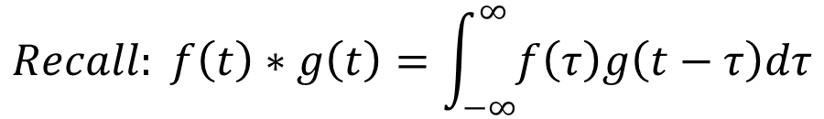

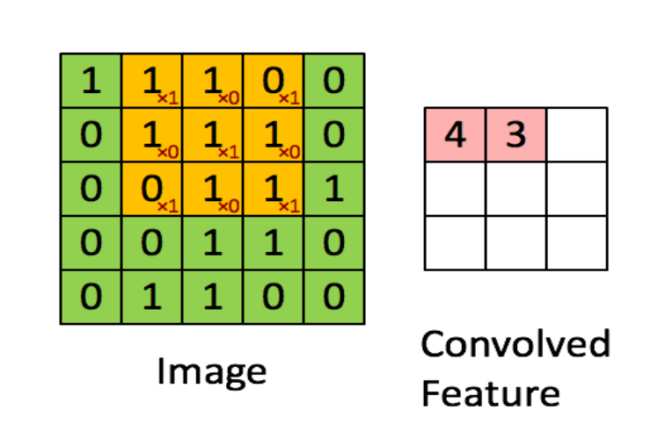
Convolution Layer
1 | 0 | 1
0 | 1 | 0
1 | 0 | 1
Kernel
Convolution is the process of sliding a kernel (filter) across the image.
The kernel act as a feature detector and outputs a feature map.
Calculation example:
(1x1) + (1X0) + (0X1) + (1X0) + (1X1) + (1X0) + (0X1) + (1X0) + (1X1) = 3
This Photo by Unknown Author is licensed under CC BY-SA

Slide 8
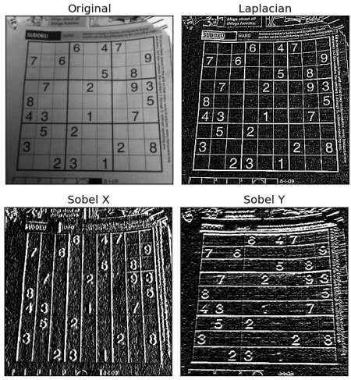
More about Convolution
To explore more about kernels: https://setosa.io/ev/image-kernels/
Notes:
Sobel operator/kernel - used for detecting boundaries (rapid change in the intensity of colour) - shows the importance of taking spatial information into consideration - reason why we use CNN. Superpositioning of kernels is possible. Applying kernels separately to an image is equivalent to summing the kernels and applying it once to the image (excluding loss of edge pixels).
Used to manually define the kernels/filters for computer vision. With machine learning, the model can come up with the kernels. (e.g. Sobel operator can only boundaries in one direction). Inspect what the machine-learnt kernel are doing (features identified)

Slide 9

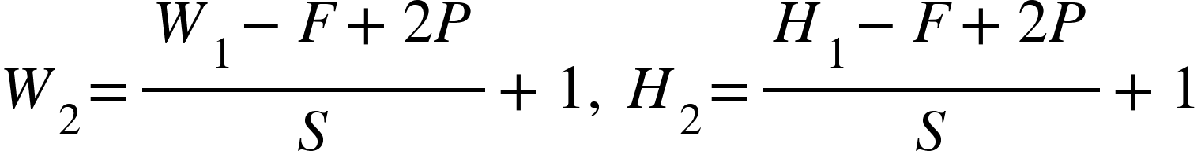
Things to note
Stride
Number of pixels moved by the kernel between each convolution. The larger the stride, the smaller the feature map output. Also it reduces the overlap between the receptive fields.
Padding
Image “shrinks” due to application of convolution. Padding is used to prevent the lost of pixels at the edge of the image. Typically we will pad with ‘0’s or values at the edge.
Output Size
Depends on Input Size (W,H), Number of Kernels (K), Kernel Size (F), Stride (S), Padding (P). Apply formula K times for each kernel applied.

Slide 10
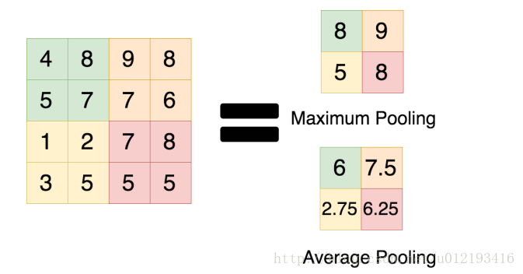
Pooling Layer
Downsampling for dimensionality reduction.
Shortens training time due to reduced parameters
Prevents overfitting
Types of Pooling (typically 2x2 window)
Maxpooling - obtain brightest pixel in the window
Minpooling - obtain darkest pixel in the window
Average Pooling - smooths by taking average of all values in window

Slide 11
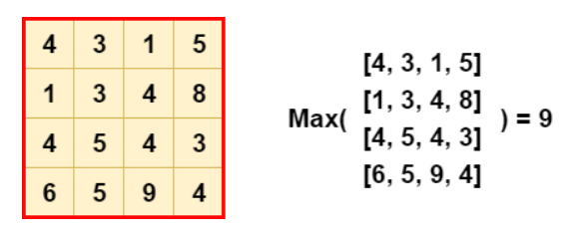
Global Pooling
Set pool size equal to the input size from the previous layer, so the max of the entire input is computed as the output value.
Dimensionality reduction
Reduce overfitting
Flattening layer
Could be used to replace fully-connected layers
Notes:
Convolution layer is like template matching: u search for a pattern in the image. Stacking up convolution layers means u r searching for a more complex pattern/object
Doing global pooling is like asking "does this pattern/object exist in the image?" because it aggregates information across spatial informations.

Slide 12

Fully Connected Layers
Fully Connected Layers have the same architecture as ANNs.
The output of both convolution and pooling layers are 3D volumes, but a fully connected layer expects a 1D vector of numbers.
Could use Flatten to unwrap image array from 2D to 1D array. However, spatial information would be discarded.

Slide 13
Why do we use CNN for images?
Specially good on data with spatial relationship
Great with high-dimensionality
Implicit feature detection
1D CNN | 2D CNN | 3D CNN
Natural Language Processing | Image Classification | Object segmentation in 3D imaging (medical)
Time-series forecasting | Audio Processing | Action detection (temporal)
Notes:
Relatively heavier.
ANN learns global patterns, CNN learns local patterns. Key characteristic of CNN: The patterns they learn are translation invariant (any points in image), They can learn spatial hierarchies of patterns

Slide 14
Implementing CNN with Tensorflow
Quick demonstration with implementing CNN using Tensorflow:
https://colab.research.google.com/drive/1MzDWi6R-TZaeWX36Z6G3CorGaLCRcIiA?usp=sharing
We have only learnt about the basic CNN structure, however there are other components involved in implementing a CNN:
Data Preprocessing
Dropout
Loss function
Optimizer
Metrics for measuring model

Slide 15
QUIZ TIME!
Please take a look at Zoom polls

Slide 16
Break Time

Slide 17
Transfer Learning
Problem:
Good Deep Learning Model requires
A lot of data
A lot of storage to store data
Model with a lot of layers, parameters to train
Train for a very long time, through thousands, millions of epochs
Computing power (CPU, GPU, TPU)
Normal people don’t have access to the infrastructure and computing power as the research institutions or corporations
How to get good model? For projects, for competition with time limits?

Slide 18
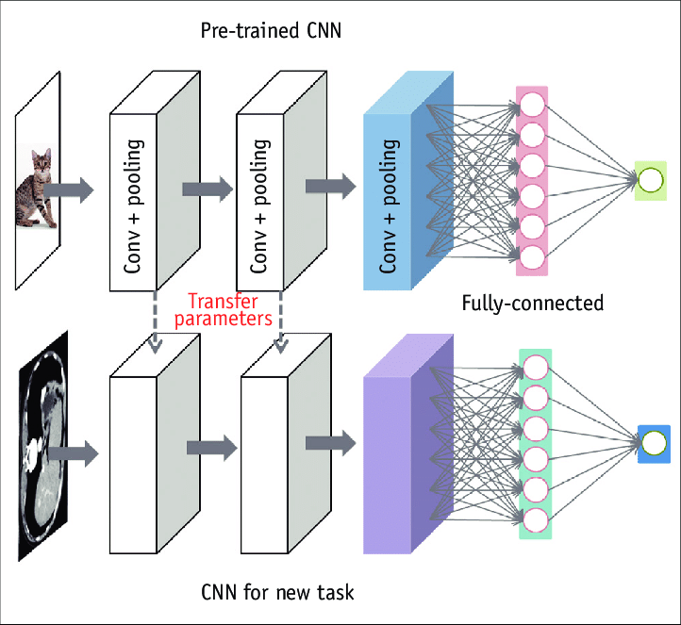
Transfer Learning
Adopt existing pre-trained models (base model) effectively serve as a generic model of the visual world
Add our own additional layers and Train on new data to suit our new task
The additional layers are the classifier layer for our new task
Train the top few layers + added layers
Use the representations learned by previous network
Repurpose feature maps (weights and biases) from previous datasets

Slide 19
Implementation
Models
Keras application: https://keras.io/api/applications/
VGG16: The model achieves 92.7% top-5 test accuracy in ImageNet, which is a dataset of over 14 million images belonging to 1000 classes
Large datasets with multiple classes
Fine Tuning:
Train with base model untrainable
Train with some of the last layers of the base model trainable
If the newly added classifier layer has randomly initialized weights, the change in the base model weights will be large
The model will “forget” what was learned

Slide 20


Moving forward
So where do we go from here?
PyTorch vs Tensorflow?
Resources?
Hands-On Machine Learning with Scikit-Learn, Keras, and TensorFlow, 2nd Edition
Pattern Recognition and Machine Learning, Christopher M. Bishop
Kaggle, Github, Youtube
Research papers (Too hardcore)
Suggested learning methods?
Other transfer learning models? EfficientNet, ResNet, MobileNet
Project inspirations?
DL-enabled Cucumber Sorting
Image Recognition with EfficientNet
Real-time Objection Detection with YOLOv4

Slide 21
THANKS
Does anyone have any questions? Please help us to fill up this feedback form: https://forms.gle/24pjZSwuVAwhnRpt5

